Slide 1


NEW TRENDS IN SHOPPING
Groups:
Đỗ Quốc Khánh
Bùi Văn Anh Huy
Nguyễn Nhật Khánh

Slide 2

CONTENTS
New trends in shopping
1
Amazon Go
2
Trends and the need
3

Slide 3
The emergence of new trends
In history
The current situation
The emergence of new trends

Slide 4
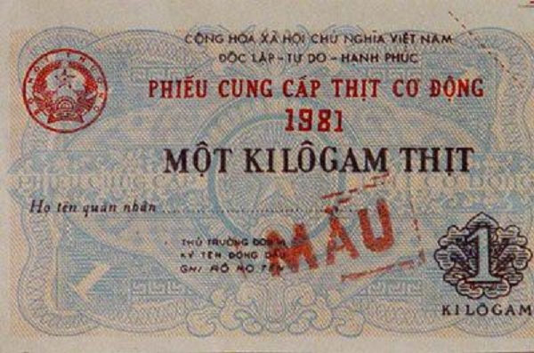
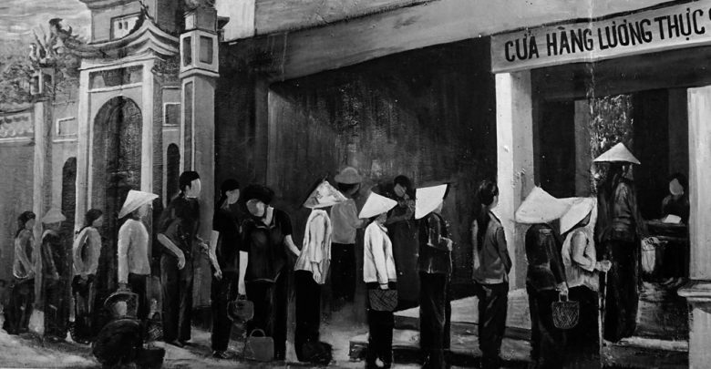
Open economic era
Easily buy food
1999
2000
Very time-consuming

Slide 5

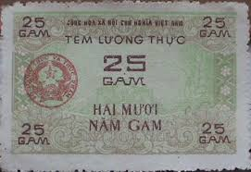
Subsidy period
In 1976-1986:
01. People lined up to buy things
02. Very time-consuming

Slide 6
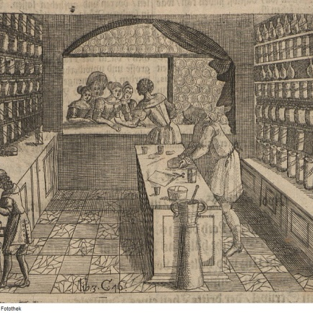
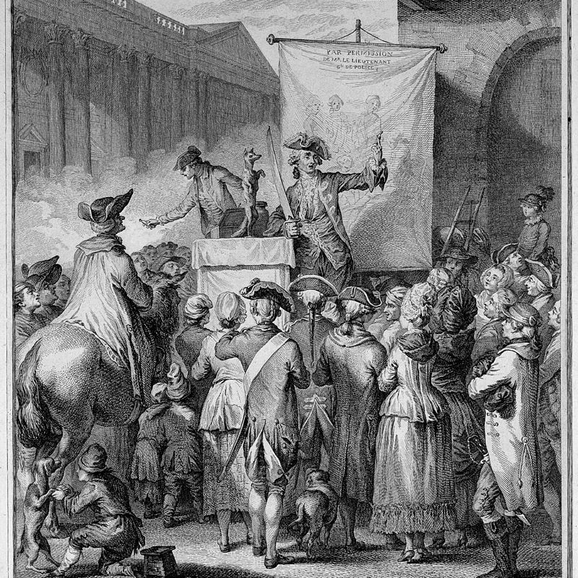
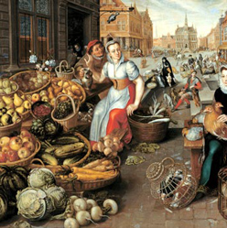
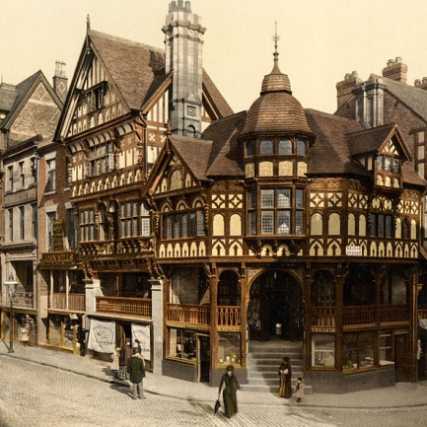
Open economy era
In 1990 - 2000
01. Grocery store appearance
02. Shopping mall
03. Market street

Slide 7




Until Internet was popular
E-commerce was born

Slide 8
Worldwide top ten retailers
Rank | Company | National | 2017 revenue ($US billion) | Dominant format 2015 | Number of countries of operation 2015
1 | Walmart | United States | 500,34 | Hypermarket/Supercenter/Superstore | 30
2 | Amazon | United States | 177.86 | Online Store | 14
3 | Walgreens Boots Alliance | United States | 131.5 | Drug Store/Pharmacy | 10
4 | Costco | United States | 129.0 | Cash & Carry/Warehouse Club | 10
5 | Kroger | United States | 122.66 | Supermarket | 1
6 | Schwarz Gruppe (Lidl) | Germany | 110.05 | Discount Store | 26
7 | The Home Depot | United States | 100.9 | Home Improvement | 4
8 | Carrefour | France | 89.63 | Hypermarket/Supercenter/Superstore | 35
9 | Tesco | United Kingdom | 72.96 | Hypermarket/Supercenter/Superstore | 10
10 | Aldi | Germany | 69.18 | Discount Store | 17

Slide 9
Amazon go

Slide 10



New paradigm in shopping trends
01. New buying trends bring
02. The need

Slide 11

THANKS

